Slide 1

PROJECT – Data Science Project Using SAS
Credit card Details Binary Classification
By: Alexia (Xue Liu)
Frank (Xinfeng) ZHAO
Instructor: Prof Sun Makosso Kallyth
Date: 2024-01-06
Metro College of Technology

Slide 2

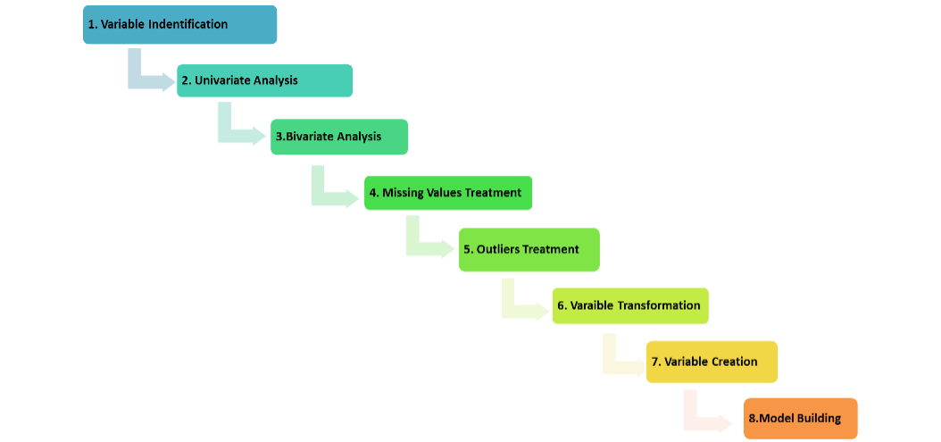
Outlines
Intorduction
Objectives of this analysis
Methodology
Study Variables
Descriptive Analysis
Diagnostics Analysis
Predictive Analysis
Prescriptive Analysis
High Level Findings
Recommendations
Appendix

Slide 3
Introduction
Data Source : Data is taken from Kaggle: https://www.kaggle.com/datasets/rohitudageri/credit-card-details/data.
The dataset contains 19 variables and 1,548 observations. There exist missing values, no duplicate data are found.
Describe : Analyzing the customer’s information from the dataset, including credit history, income, employment status, and other relevant features, to predict whether an applicant is likely to be a responsible cardholder.
Purpose : To predict the approvement of the customer’s credit card application.
10 Numerical input:
Ind_ID
CHILDREN
Annual_income
Birthday_count
Employed_days
Mobile_phone
Work_Phone
Phone
EMAIL_ID
Family_Members
8 Categorical input:
GENDER
Car_Owner
Propert_Owner
Type_Income
EDUCATION
Marital_status
Housing_type
Type_Occupation
Target:
label

Slide 4
Objectives
Primary Objective
The primary objective is typically centered around determining whether a credit card application should be approved or denied based on certain features and criteria. The primary goal is binary in nature, focusing on classifying applications into two categories: approved or not approved.
Secondary Objectives:
Accuracy: Achieve a high accuracy in predicting credit card approval status to ensure that the model makes correct predictions on a balanced dataset.
Precision and Recall: Balance precision (the ratio of true positive predictions to the total predicted positives) and recall (the ratio of true positive predictions to the total actual positives) to manage the trade-off between minimizing false positives and false negatives.
Interpretability: Ensure that the model is interpretable and provides insights into the factors influencing credit card approval decisions. This is crucial for regulatory compliance and building trust in the model.
Feature Importance: Identify the most significant features influencing the credit card approval decision. Understanding these features can provide valuable insights for decision-makers.
Fairness and Bias: Evaluate and mitigate potential biases in the model predictions to ensure fair treatment of all applicants, regardless of demographic or other protected characteristics.
Efficiency: Consider the computational efficiency of the model, especially in real-time or large-scale deployment scenarios.
Risk Management: Assess the risk associated with credit card approval decisions and incorporate risk management strategies into the model evaluation.

Slide 5
Methodology :
• Data Definitions
Ind_ID: Client ID
Gender: Gender information
Car_owner: Having car or not
Propert_owner: Having property or not
Children: Count of children
Annual_income: Annual income
Type_Income: Income type
Education: Education level
Marital_status: Marital_status
Housing_type: Living style
Birthday_count: Use backward count from current day (0), -1 means yesterday.
Employed_days: Start date of employment. Use backward count from current day (0). Positive value means, individual is currently unemployed.
Mobile_phone: Any mobile phone
Work_phone: Any work phone
Phone: Any phone number
EMAIL_ID: Any email ID
Type_Occupation: Occupation
Family_Members: Family size
Label: 0 is application approved and 1 is application rejected.

Slide 6
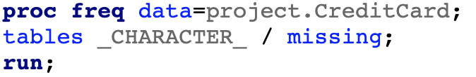
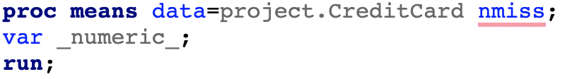
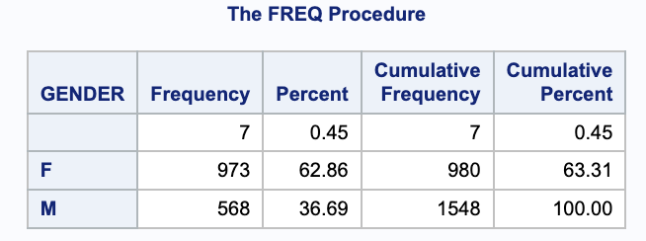
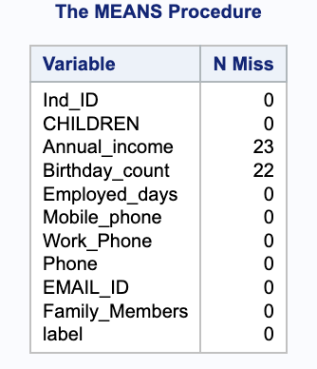
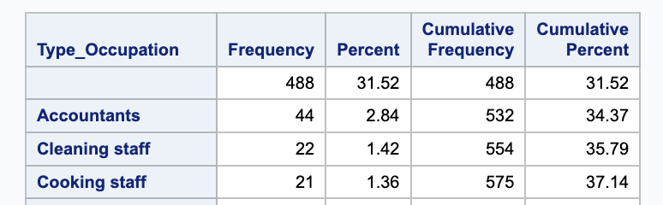
Methodology :
• Data Validation – missing values
• For Categorical variables:
• For Numerical variables:
Replace Missing Values for Gender with Mode
Replace Numerical Missing Values with Median
Replace Missing Values for Type_Occupation with "Unknown

Slide 7
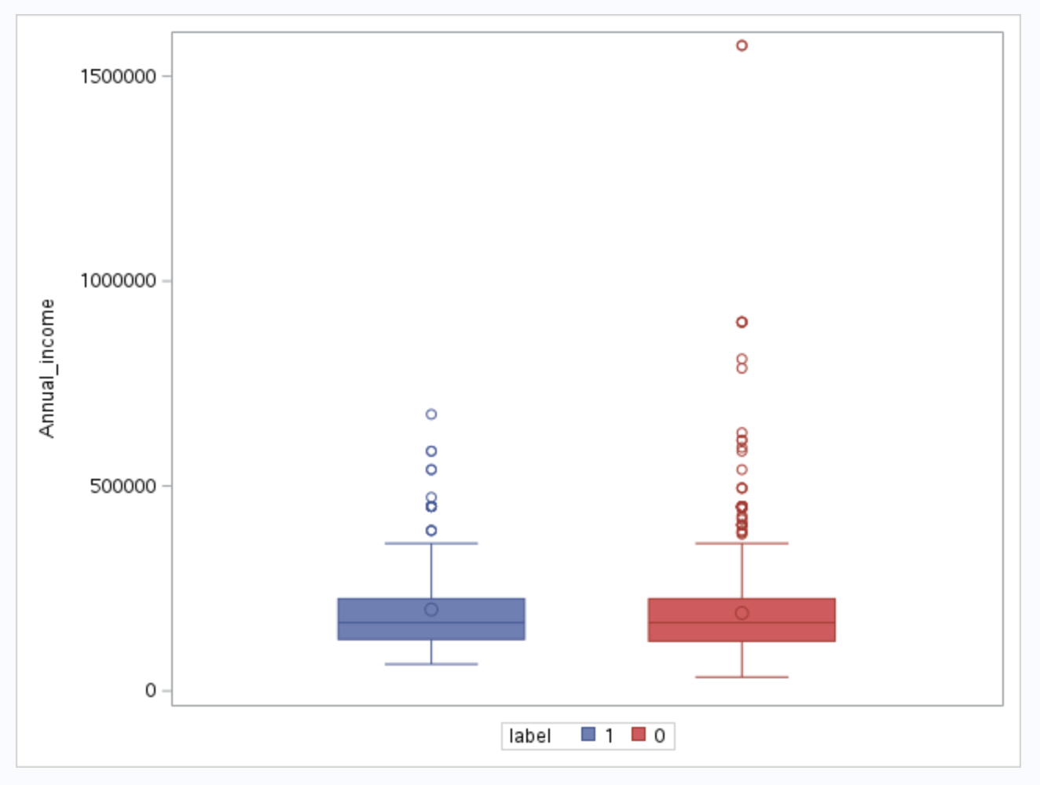
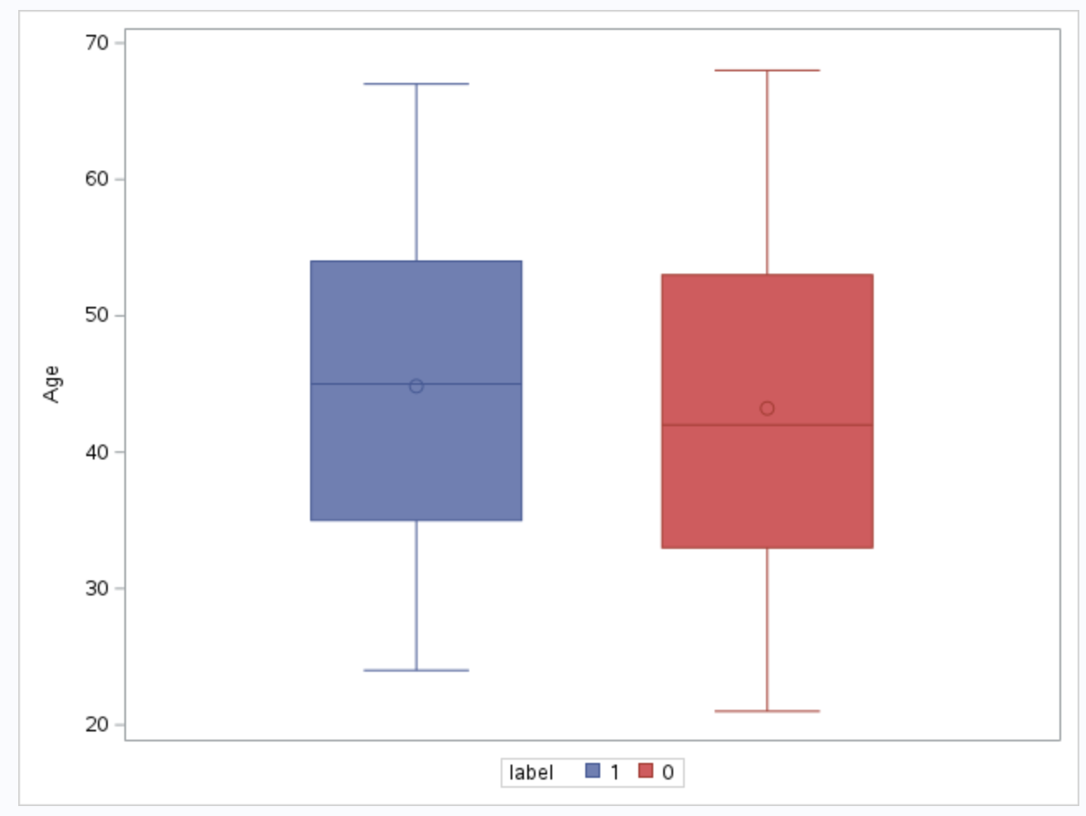
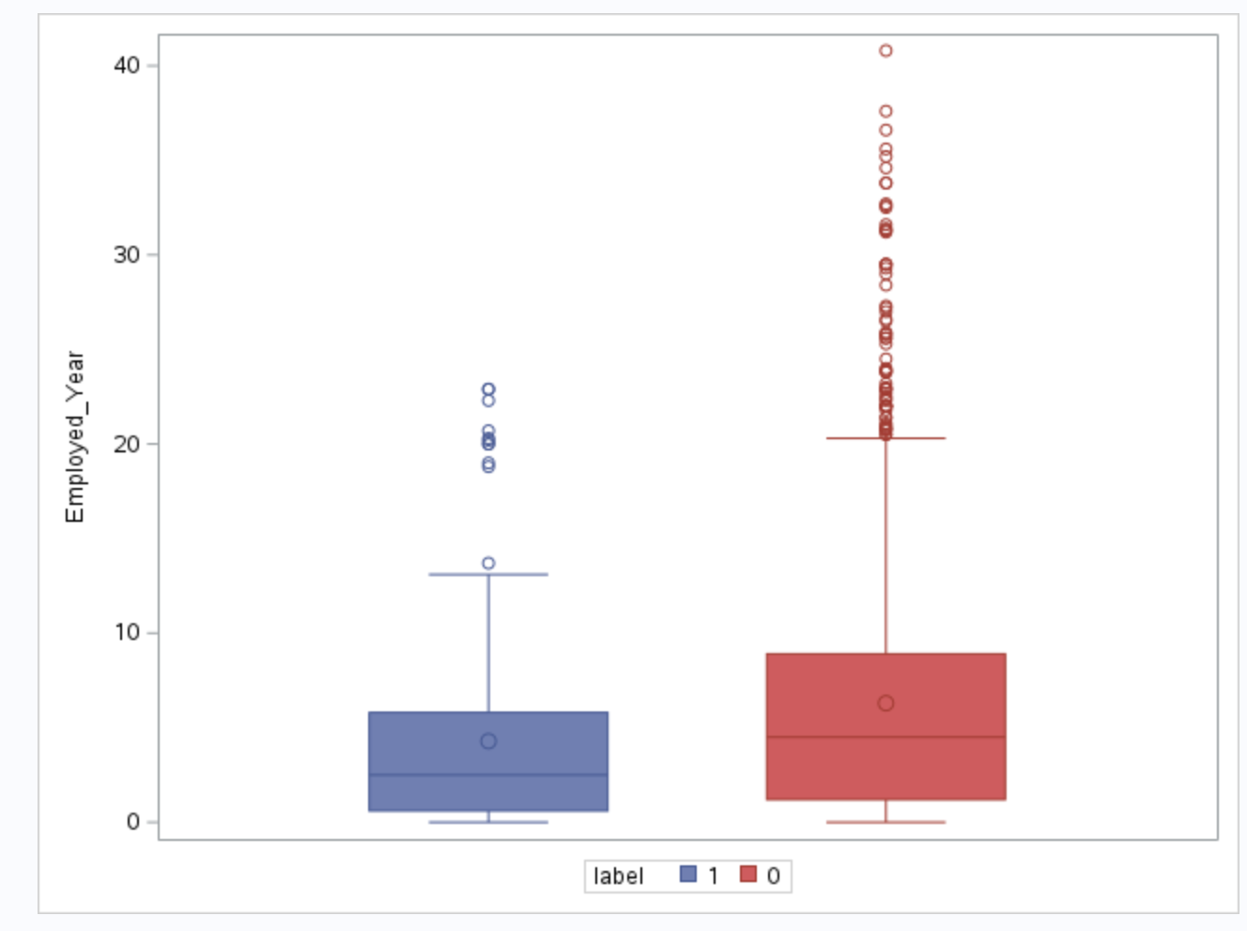
Methodology :
• Data Validation – outliers
• Annual_income:
• Age:
• Employed_years:

Slide 8
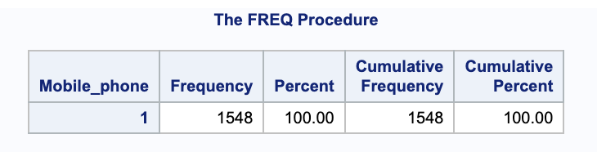
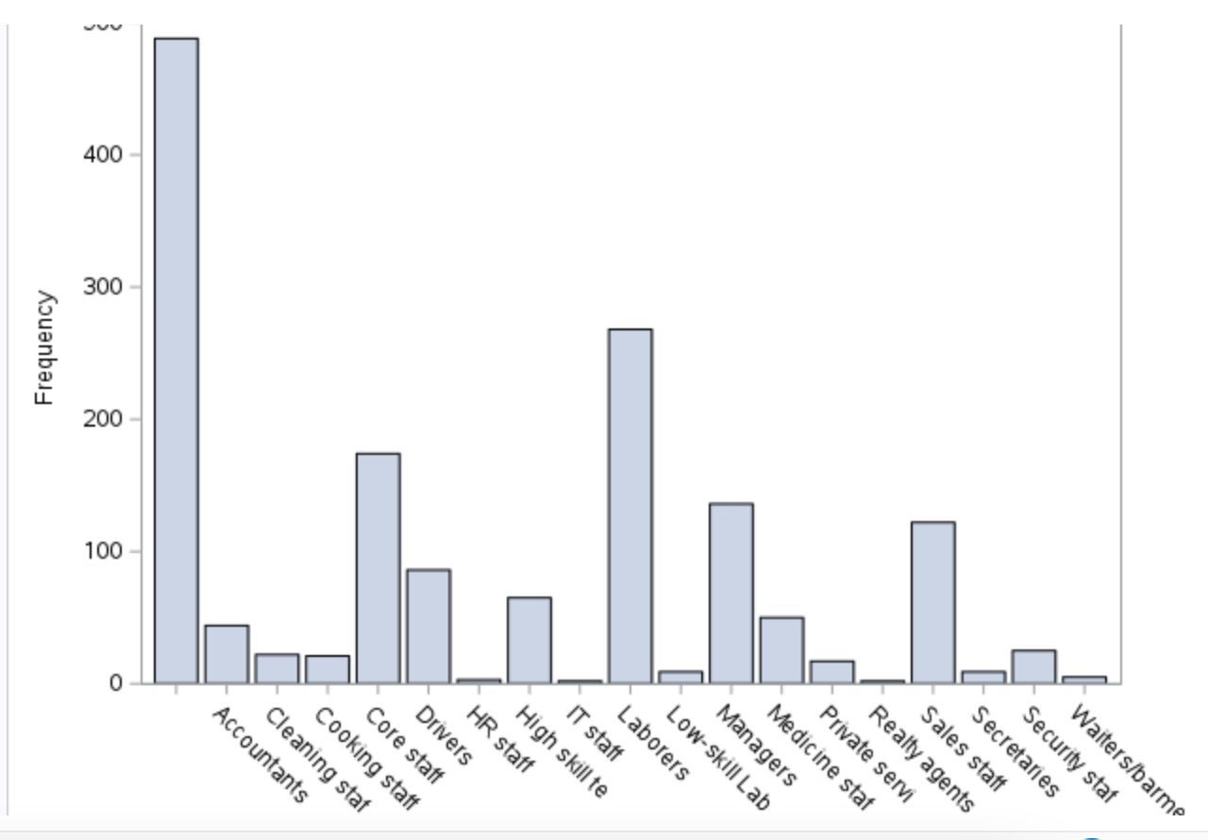
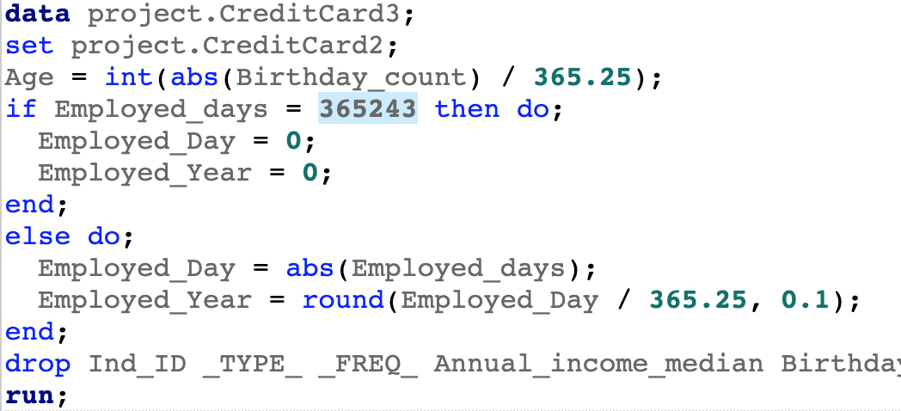
Methodology :
• Inclusion and exclusion criteria
All of the values of “Mobile_phone” is 1, so we drop the variable.
• Data Transformation
1, Type_Occupation :
Replace the value for less than 100 in each category with "Others”
2, Birthday_count:
Calculate new feature “Age” by Birthday_count
3, Employed_days:
a)Replace the value of “365243” with 0
b)Calculate new feature “Employed_Year” by Employed_days

Slide 9
Methodology :
• Statistical Methods and Techniques for your inference
• Descriptive Analysis
Proc Import, Proc Print, Proc Contents, Proc Freq. Proc Means, Proc Sort, Proc Summary, Proc Sql, Proc Sgplot, Proc Univariate, Proc Corr, Proc Sgscatter, Proc Princomp
• Diagnostics Analysis
Proc Standard, Proc Ttest, Proc Anova, Proc Glm, Proc Mixed, Proc Npar1Way, Proc Logistic, Proc Print, Proc Means, Proc Freq, Proc Univariate,
• Predictive Analysis
Proc Pls, Proc Logistic, Proc Glm, Proc Sgplot, Proc Corr, Proc Surveyselect, Proc Glmselect, Proc Rank, Proc Summary, Proc Means,
• Prescriptive Analysis
Proc Logistic, Proc Sort, Proc Freq, Proc Means

Slide 10
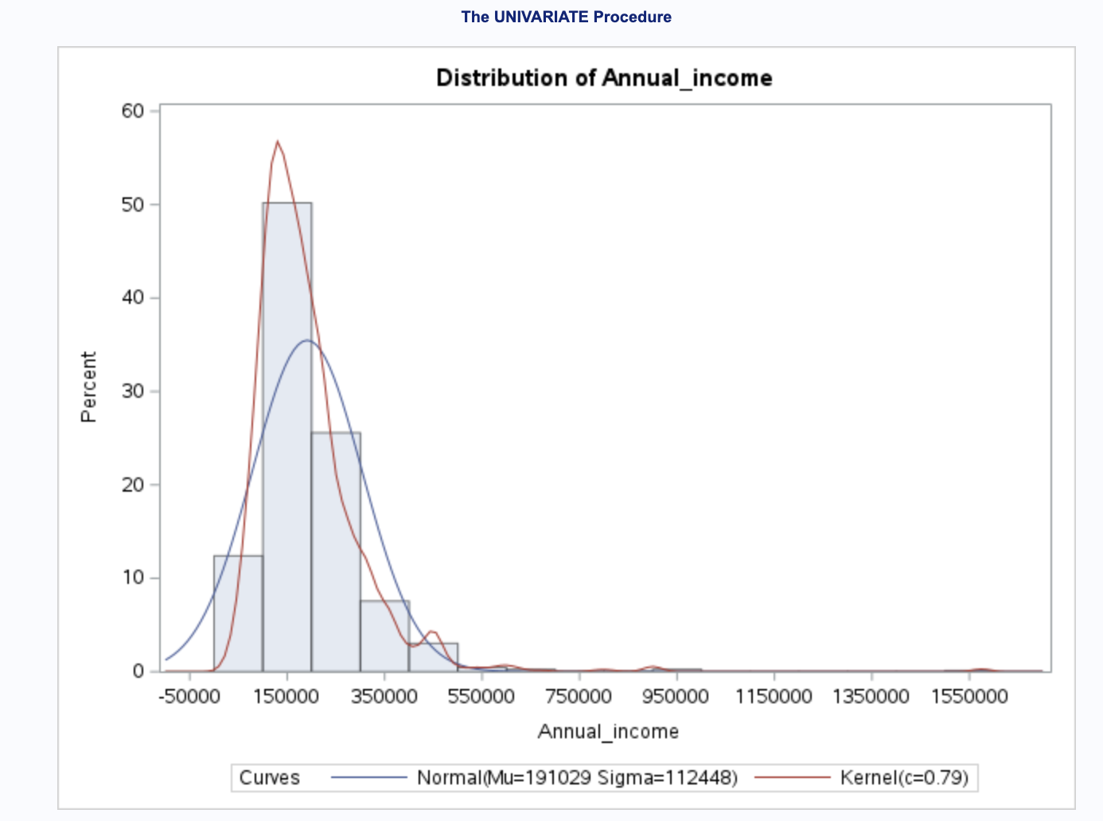
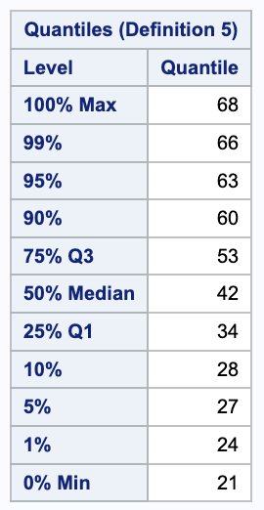
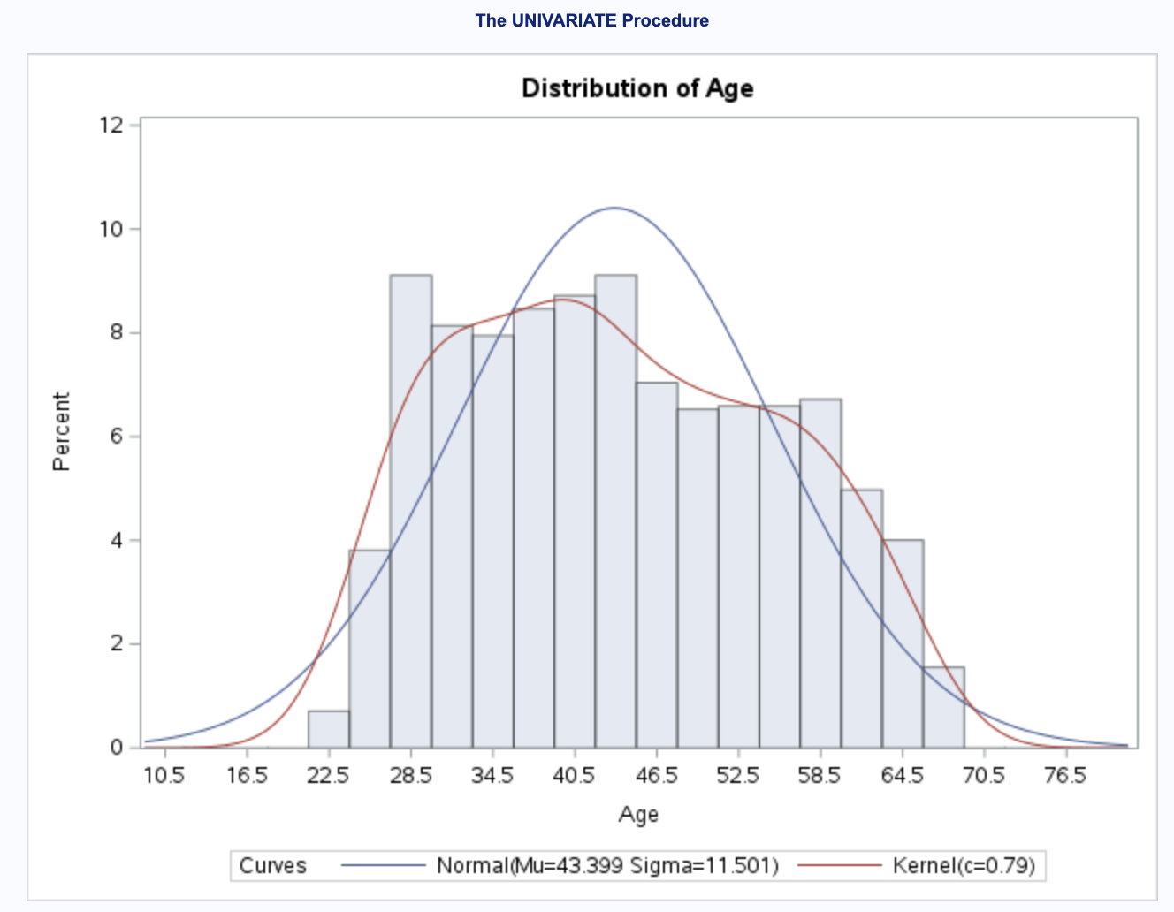
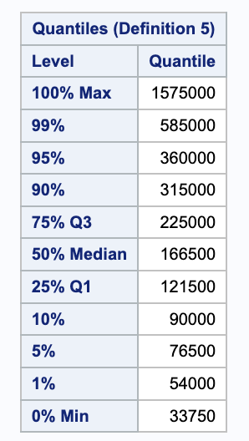
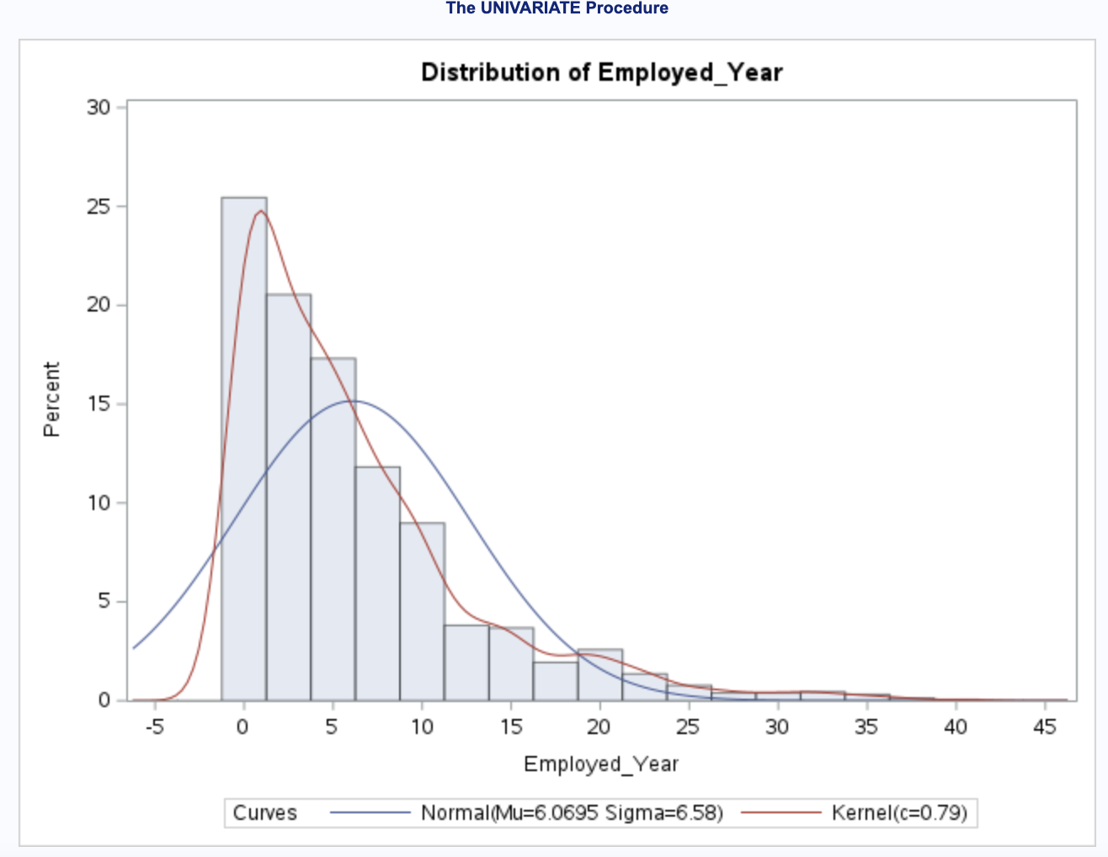
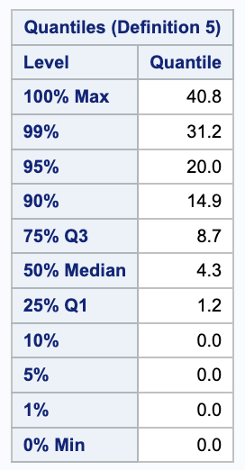
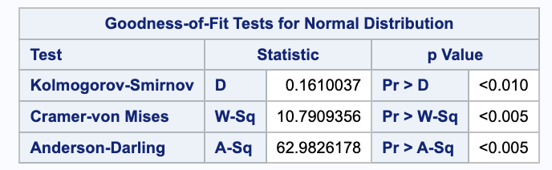
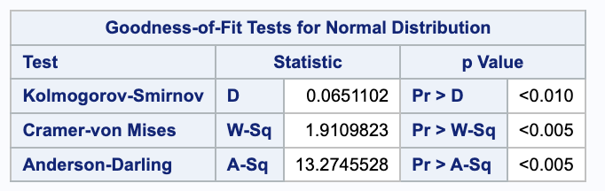
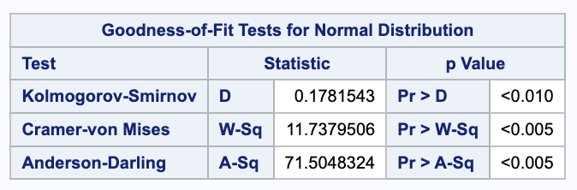
Descriptive Analysis &. Diagnostics Analysis :
• Univariate Analysis – Numerical
• Annual_income:
• Age:
• Employed_years:
Normality Diagnostics: All three tests (with small p-value (<0.005)) suggest evidence against the hypothesis that the sample comes from a normal distribution.

Slide 11
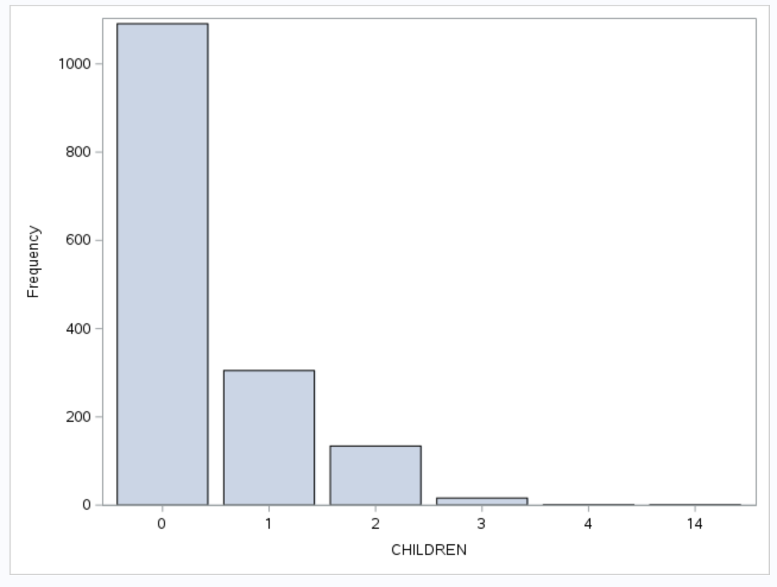
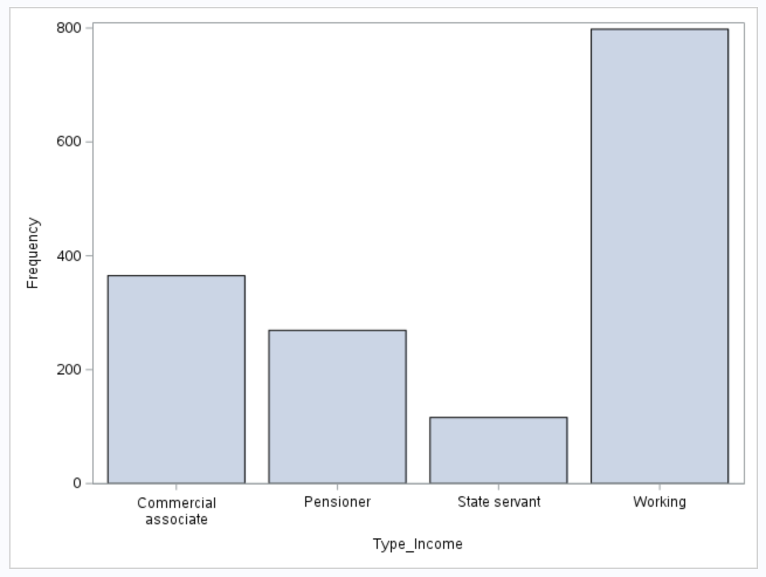
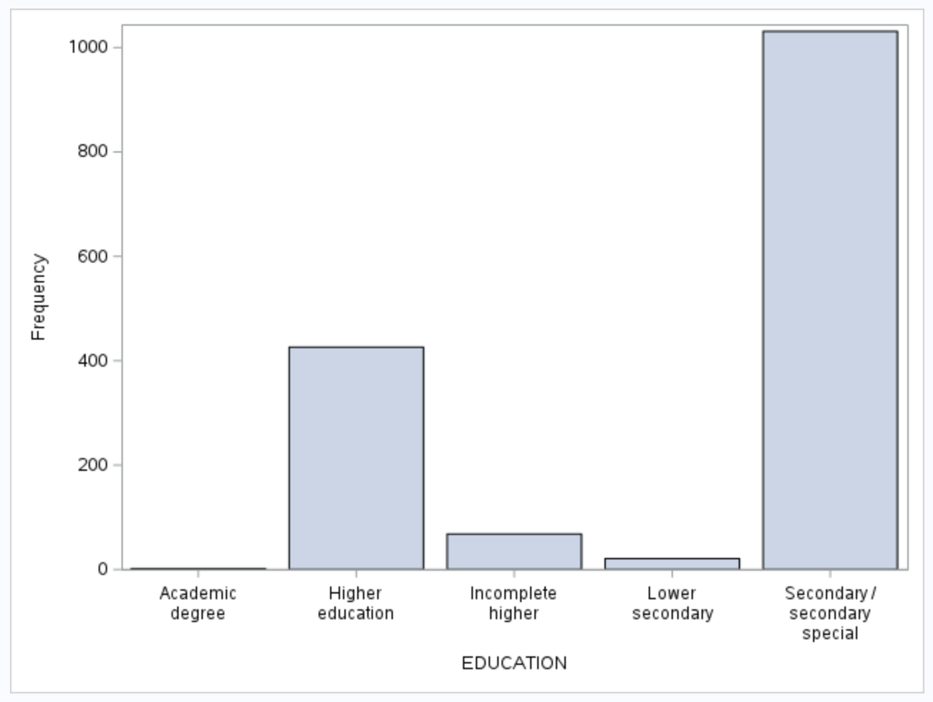
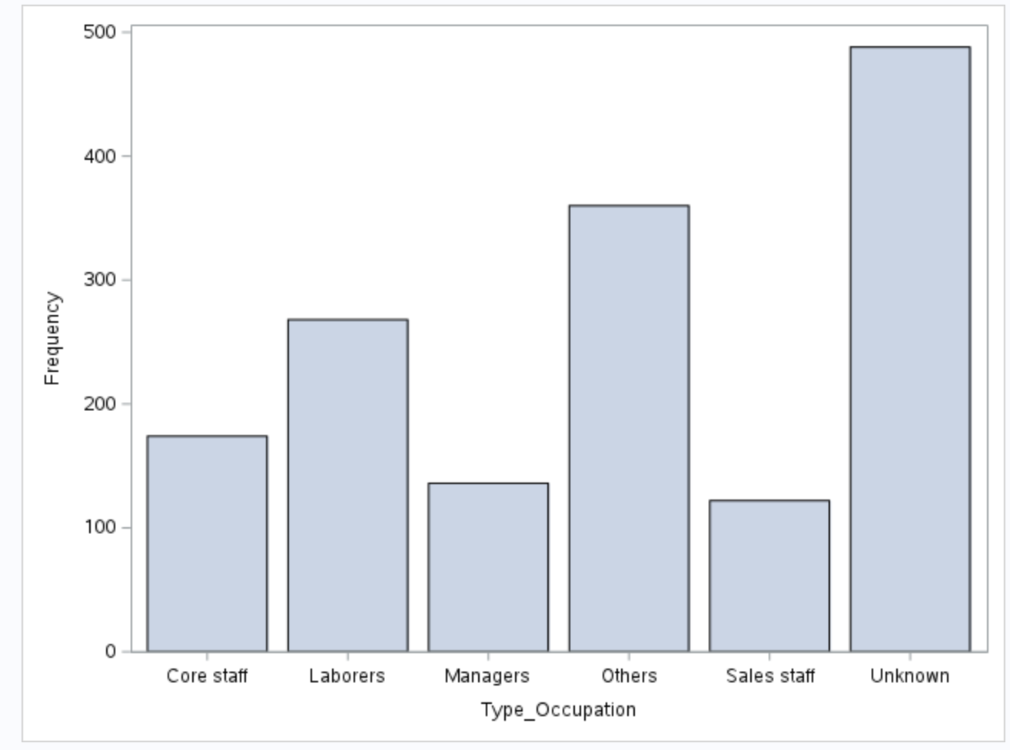
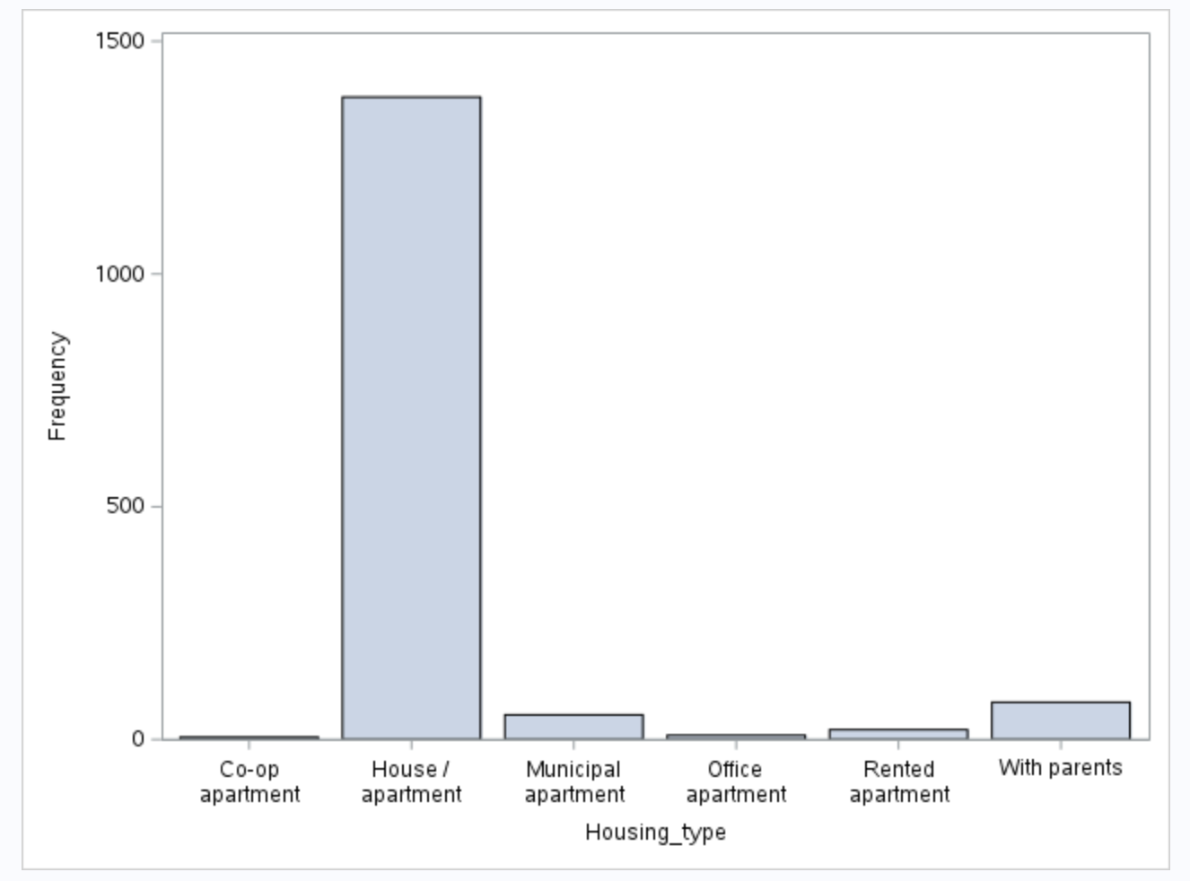
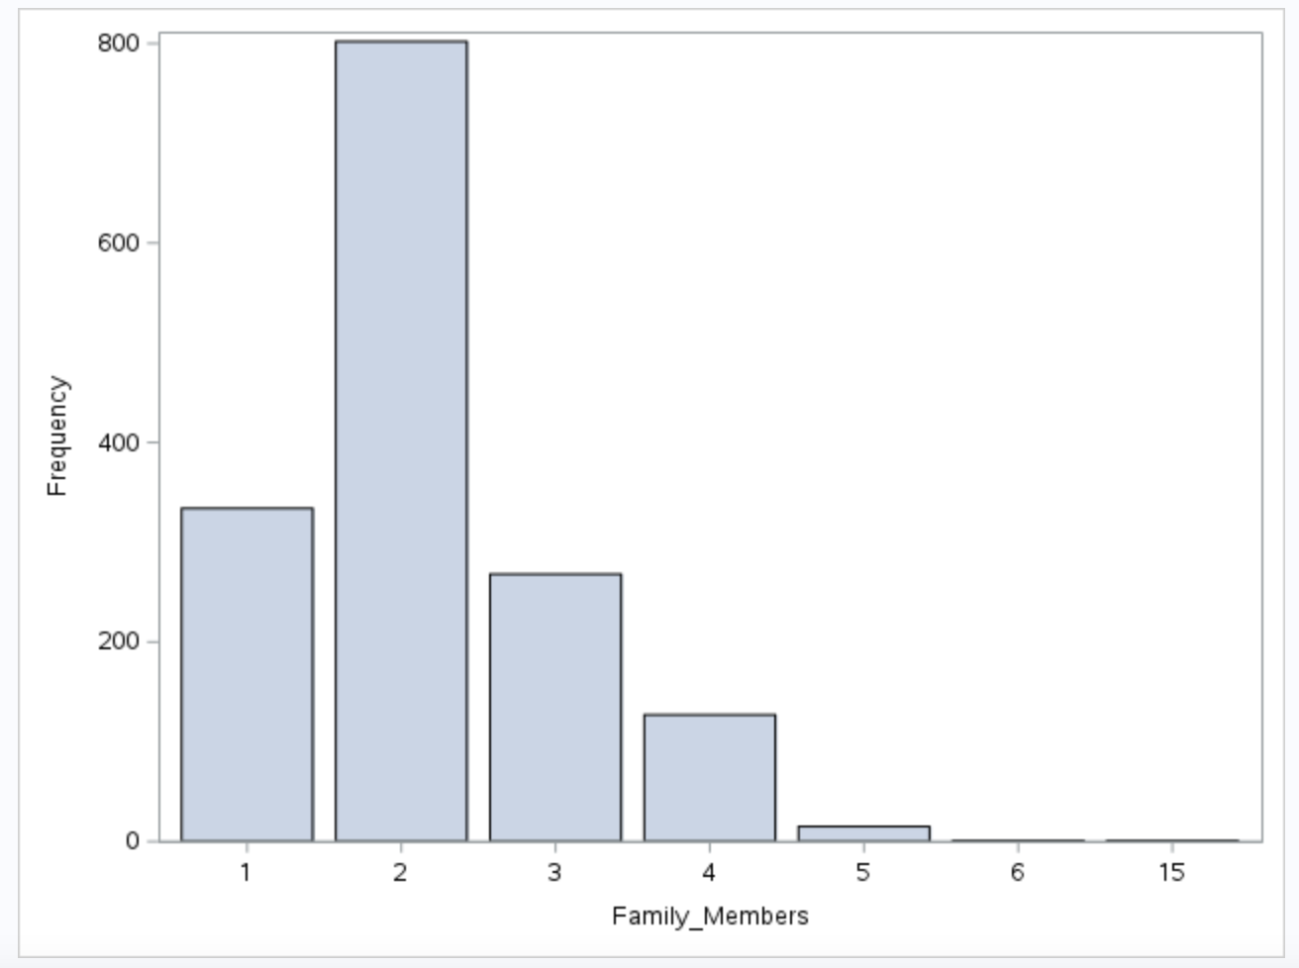
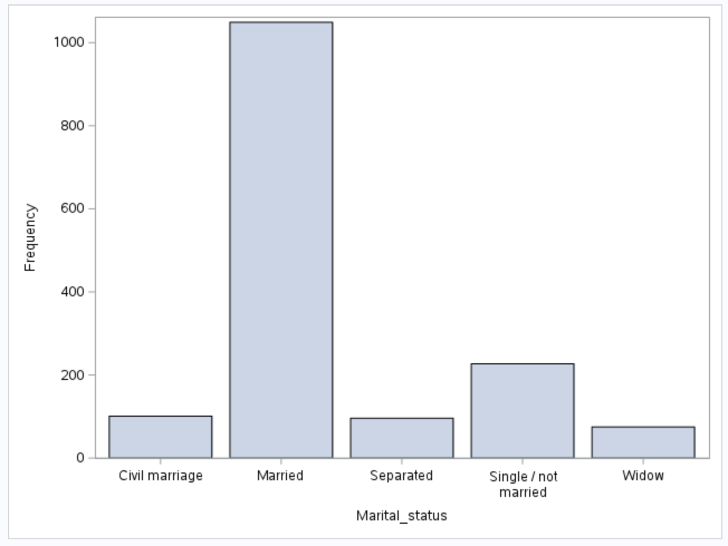
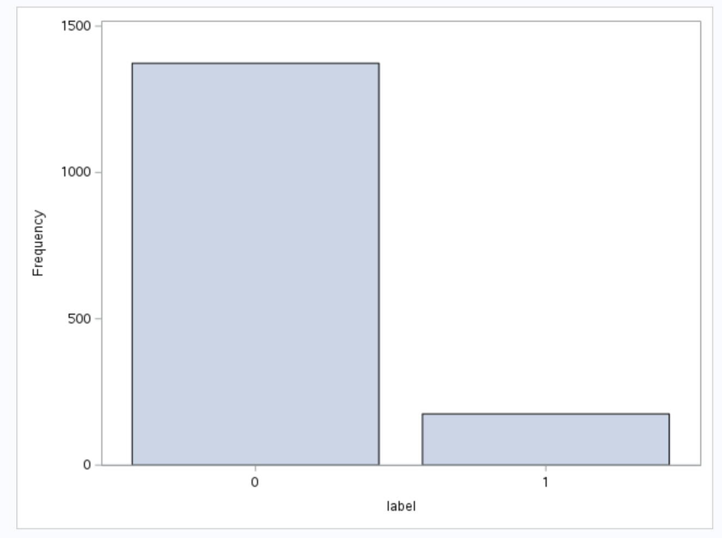
Descriptive Analysis &. Diagnostics Analysis :
• Univariate Analysis – Categorical

Slide 12
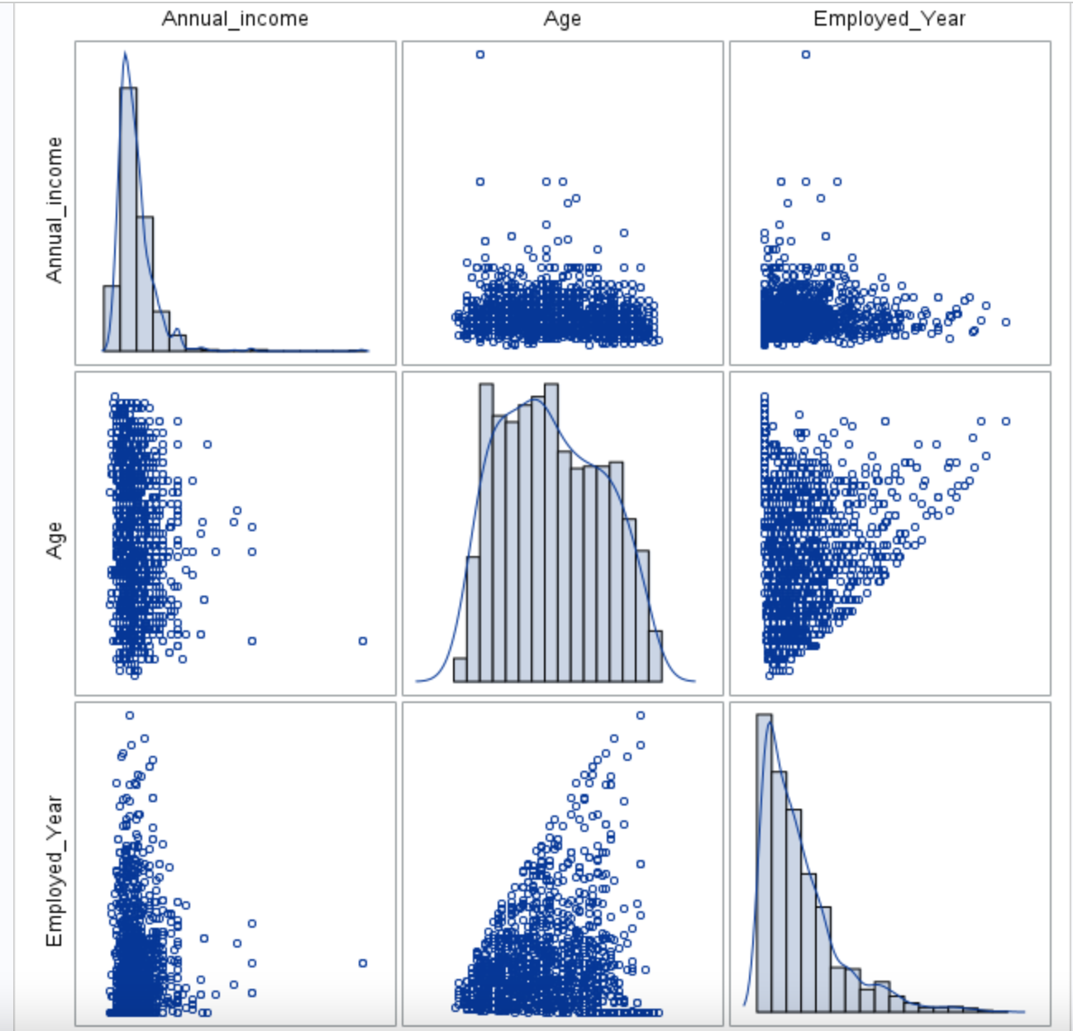
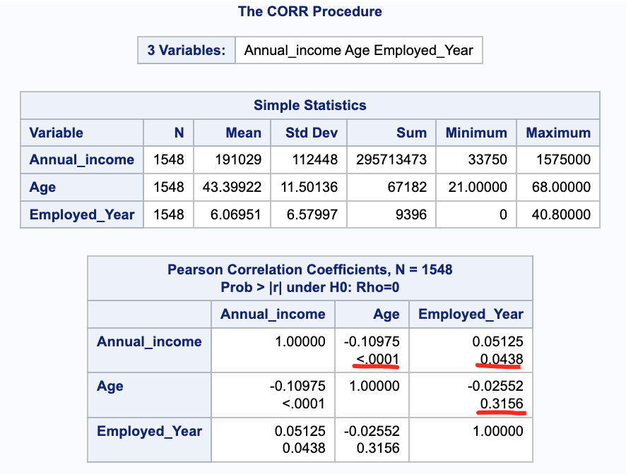
Descriptive Analysis &. Diagnostics Analysis :
• Bivariate Analysis (Numerical & Numerical)
The Pearson correlation coefficients between the variables Annual_income, Age, and Employed_Year. The correlation coefficient measures the strength and direction of a linear relationship between two variables.
Correlation between :
Annual_income and Age: p-Value: <.0001 (extremely small)
Annual_income and Employed_Year: p-Value: 0.0438 (statistically significant)
Age and Employed_Year: p-Value: 0.3156 (not statistically significant)

Slide 13
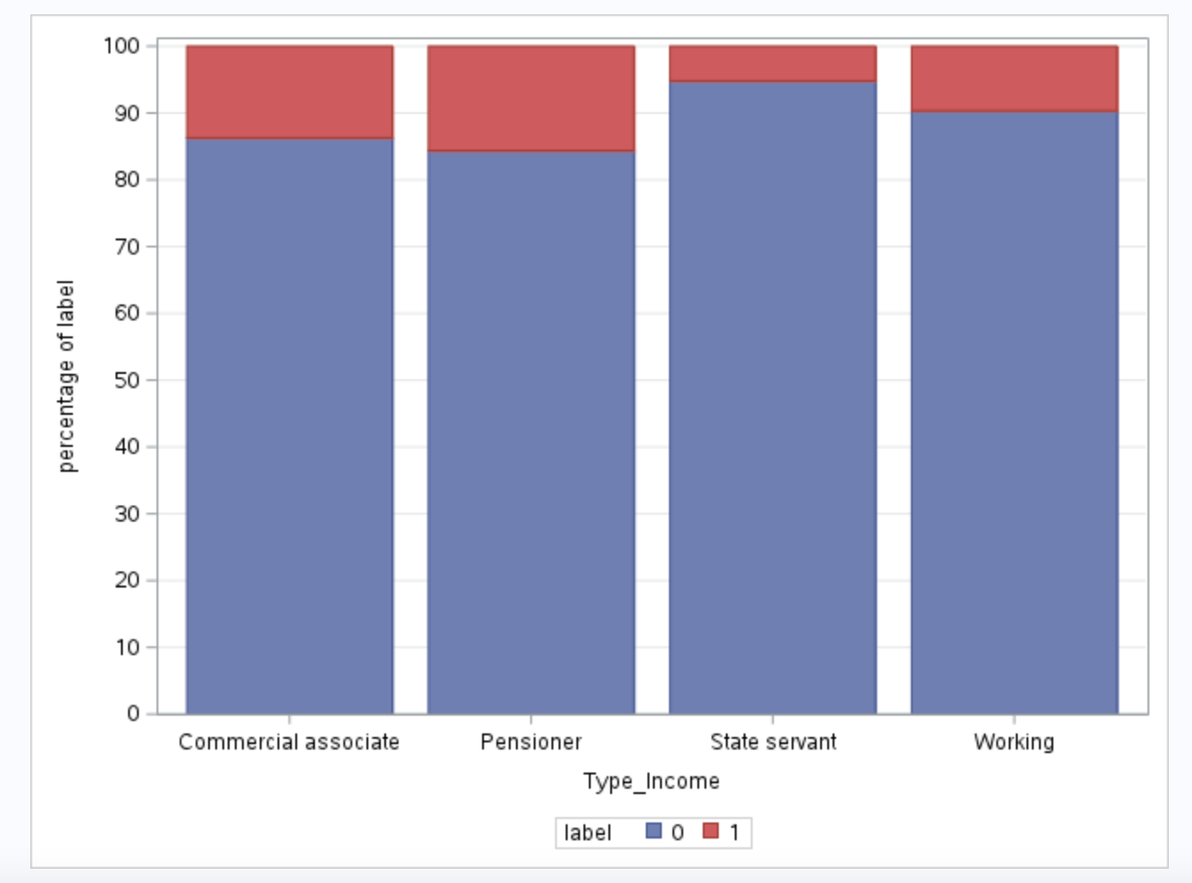
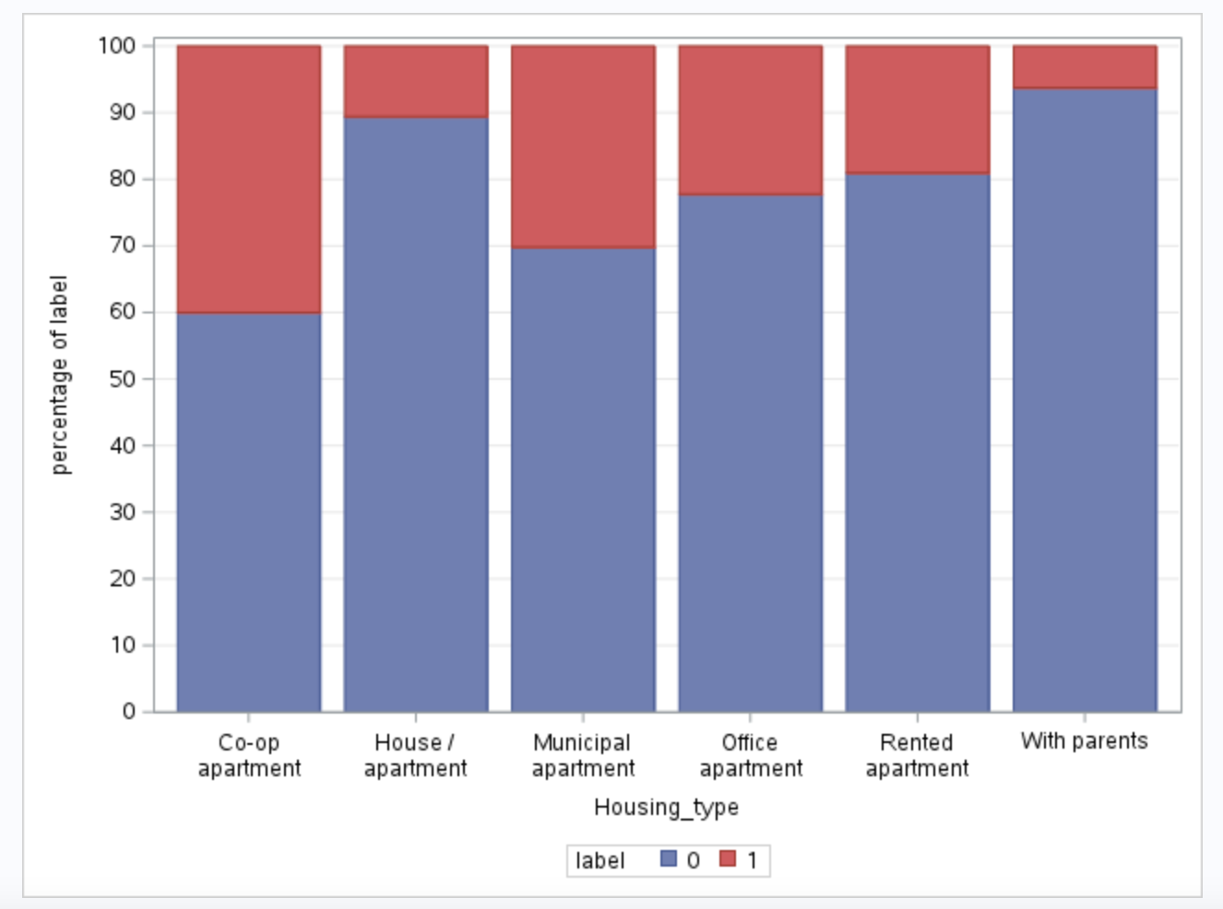
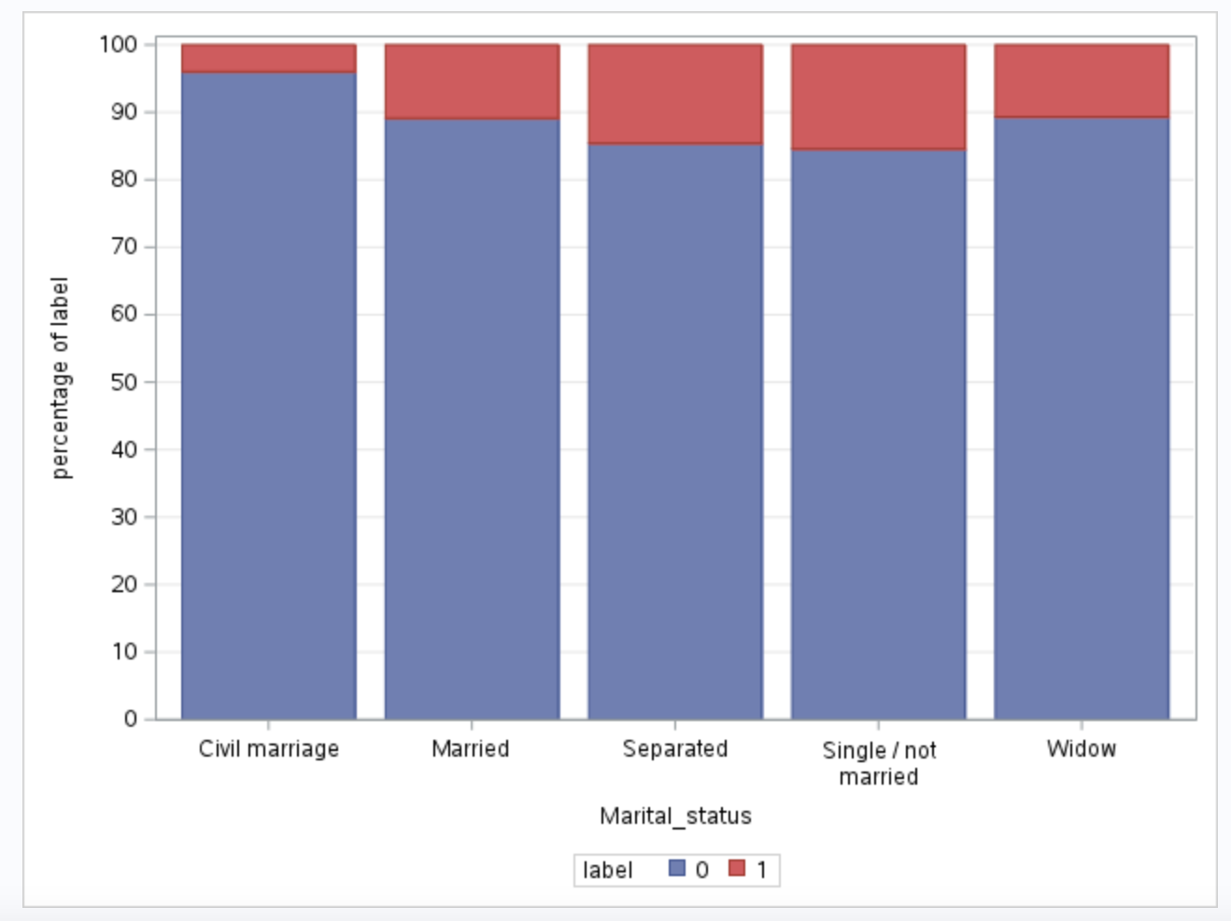
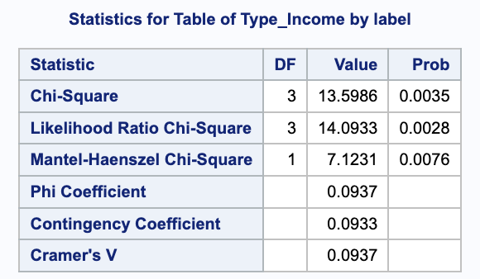
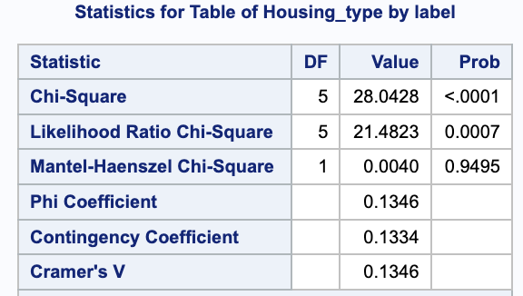
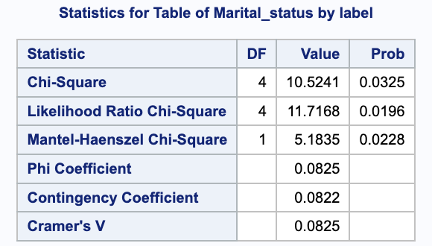
Descriptive Analysis &. Diagnostics Analysis :
• Bivariate Analysis (Categorical & Categorical) (predictor vs target )
Chi-square easures the association or independence. the probability (Prob) associated with this test statistic is less than 0.05, indicating that there is a significant association between the two variables.

Slide 14
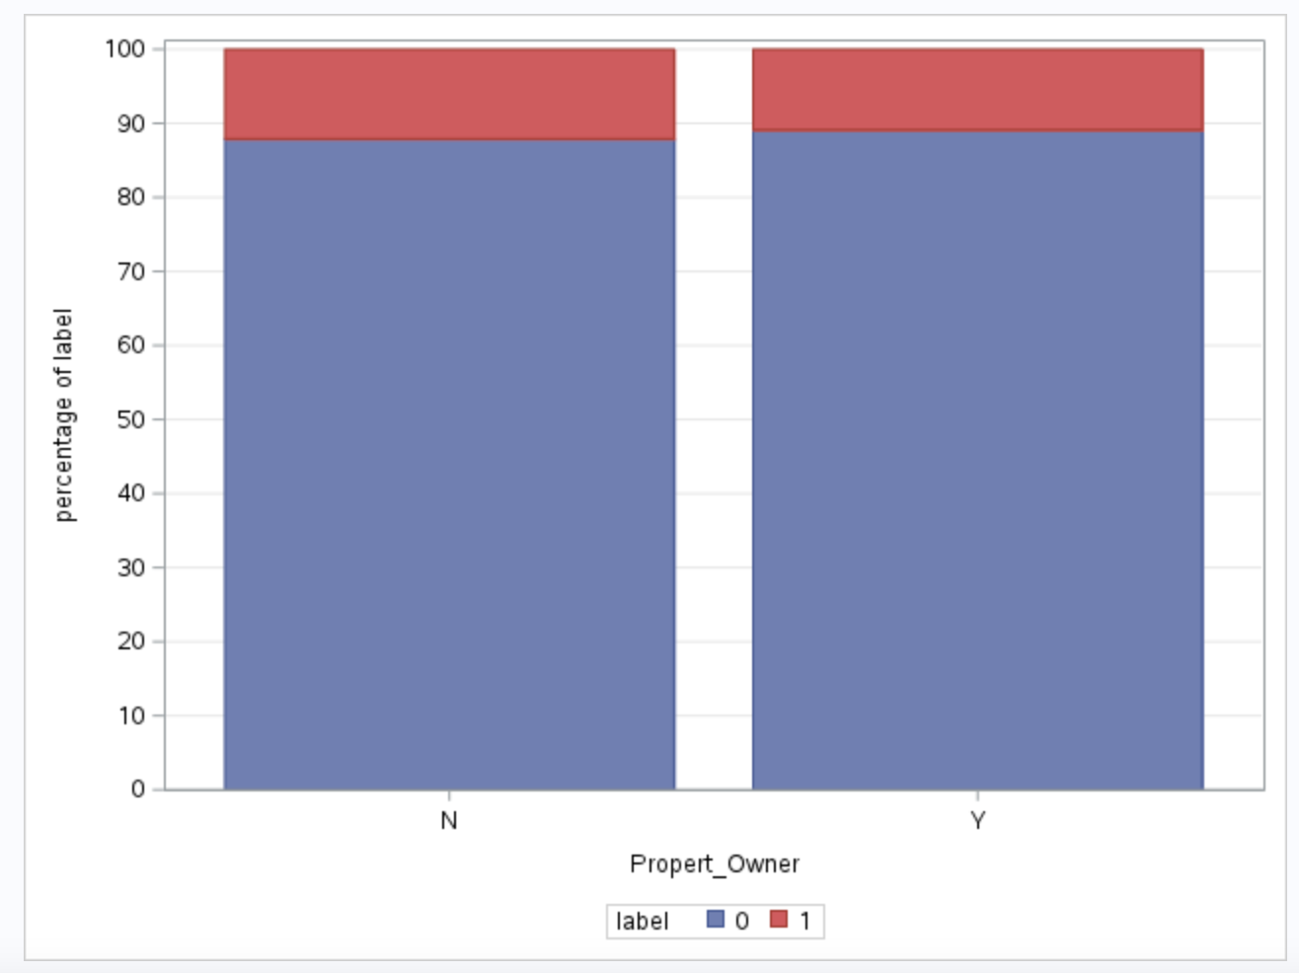
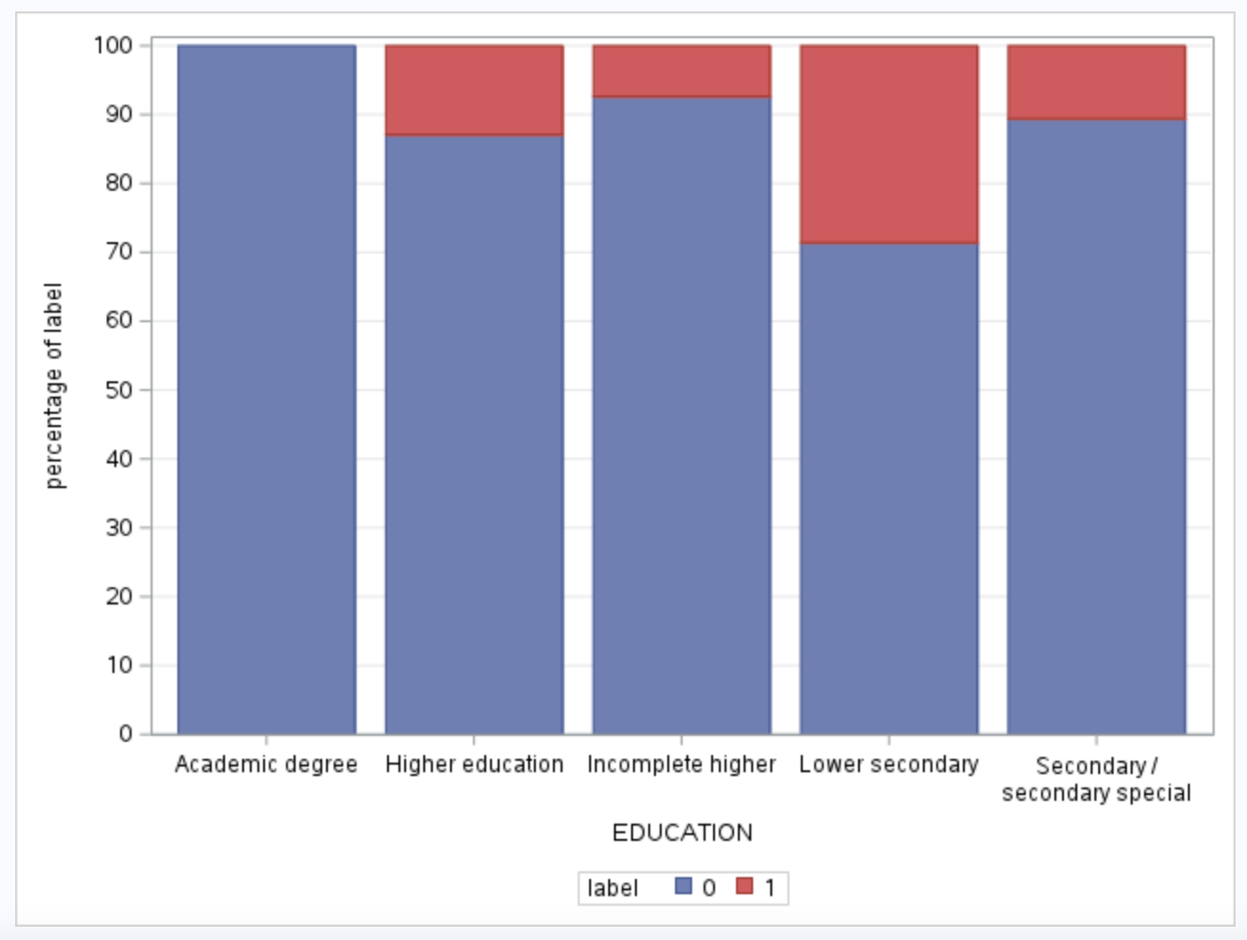
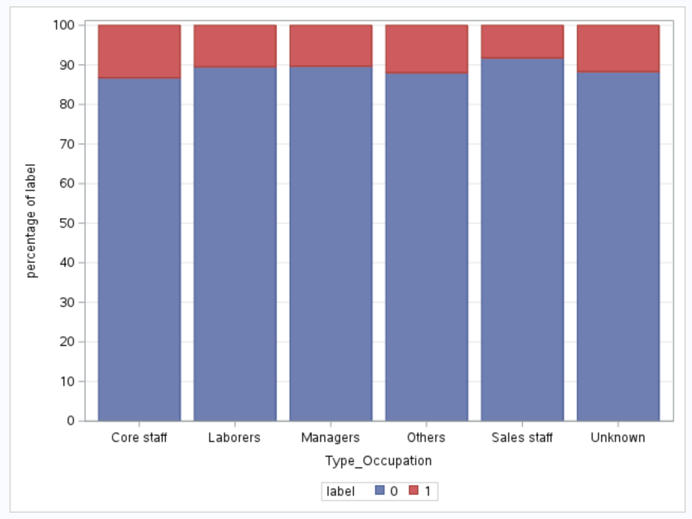
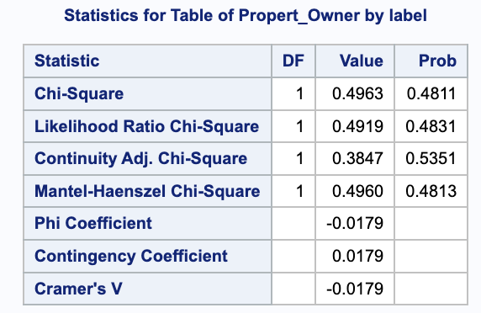
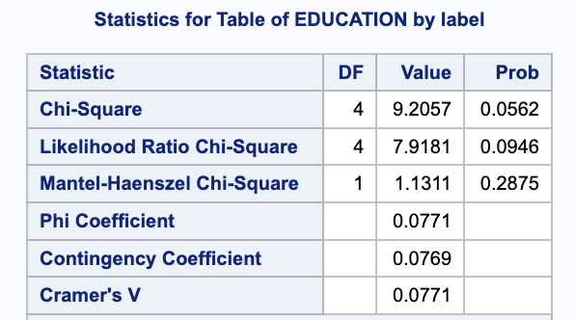
Descriptive Analysis &. Diagnostics Analysis :
• Bivariate Analysis (Categorical & Categorical) (predictor vs target )
There is NOT a significant association between the two variables

Slide 15
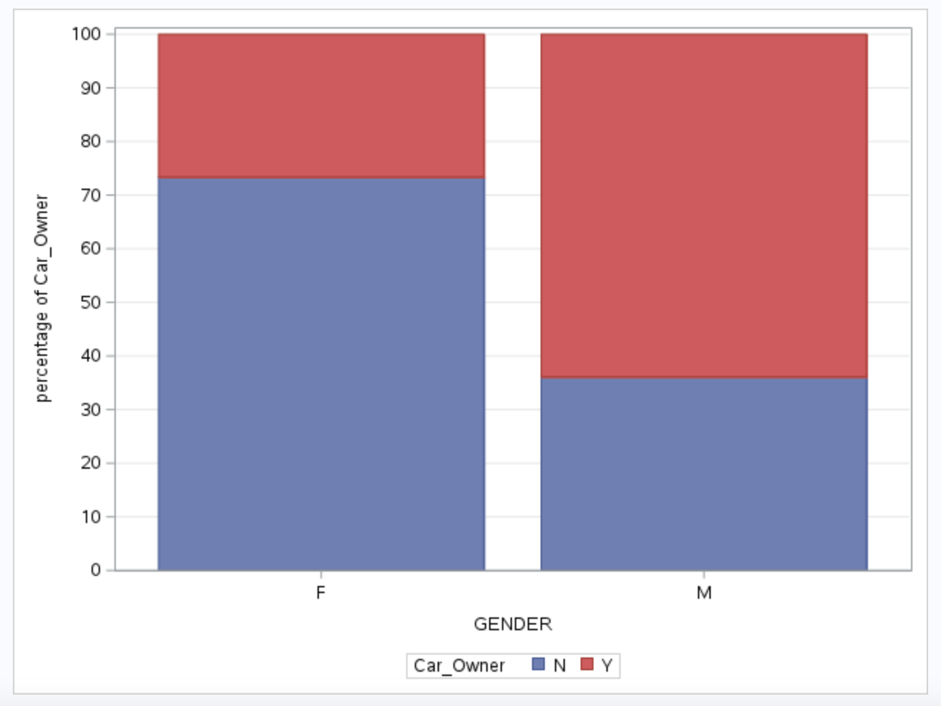
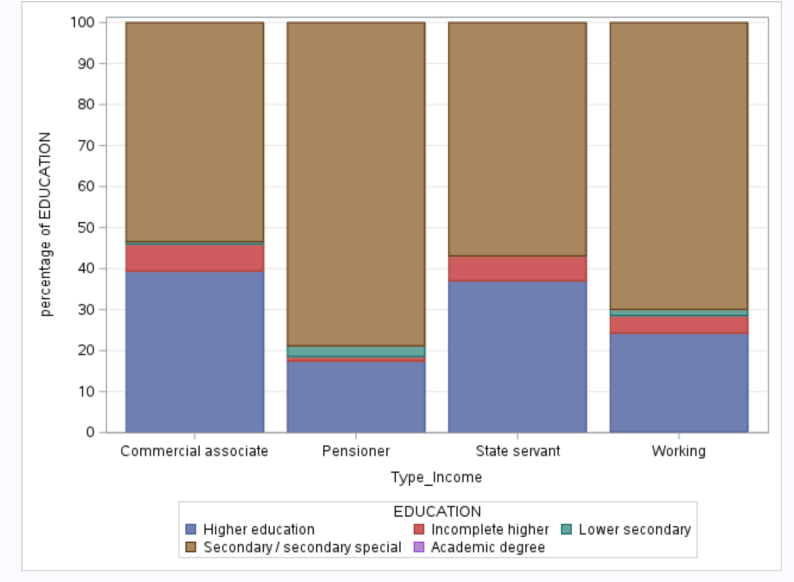
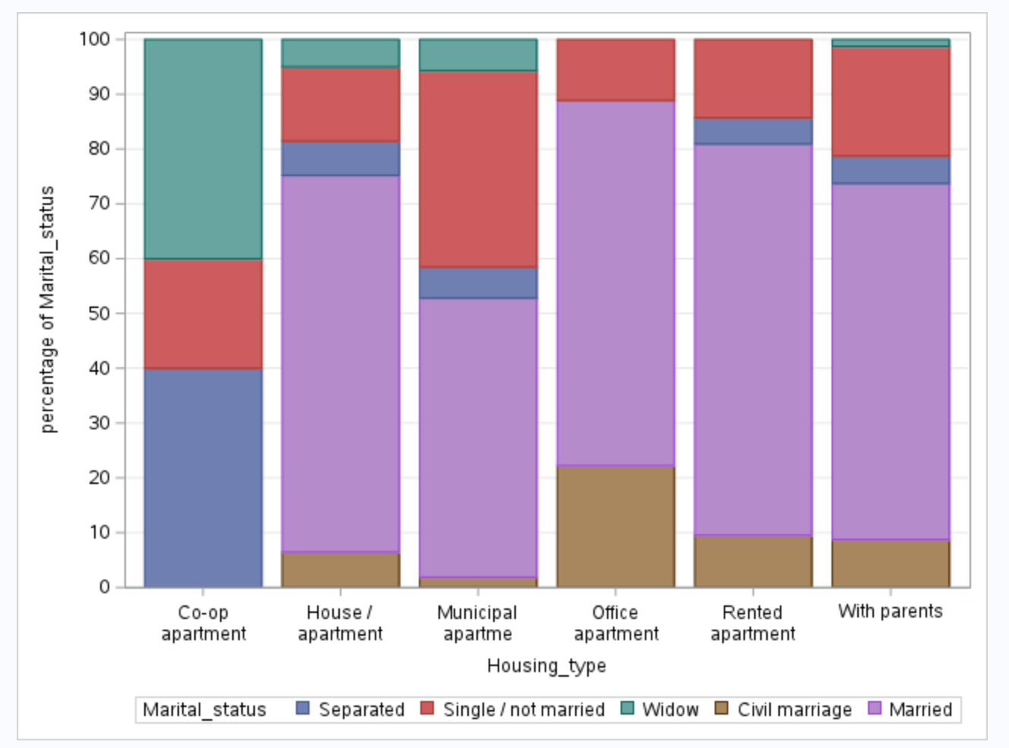
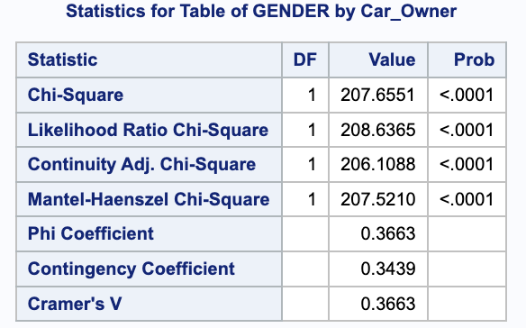
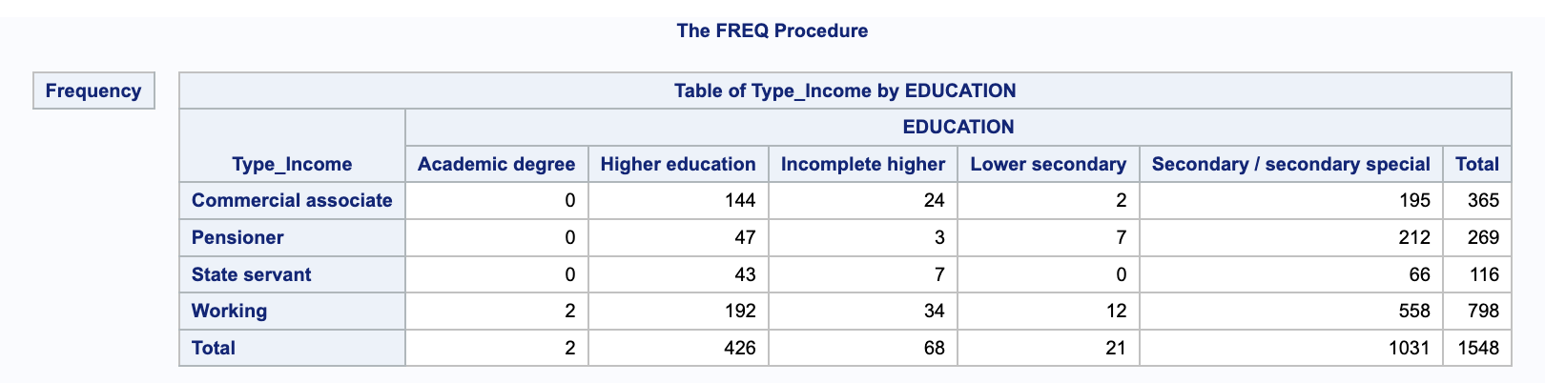
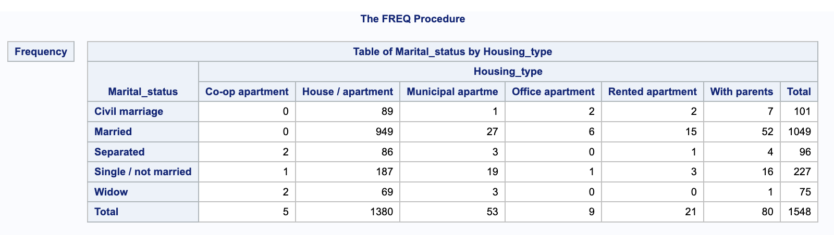
Descriptive Analysis &. Diagnostics Analysis :
• Bivariate Analysis (Categorical & Categorical) (predictor vs predictor )

Slide 16
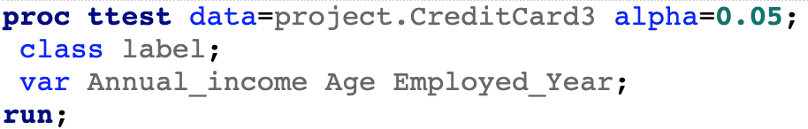

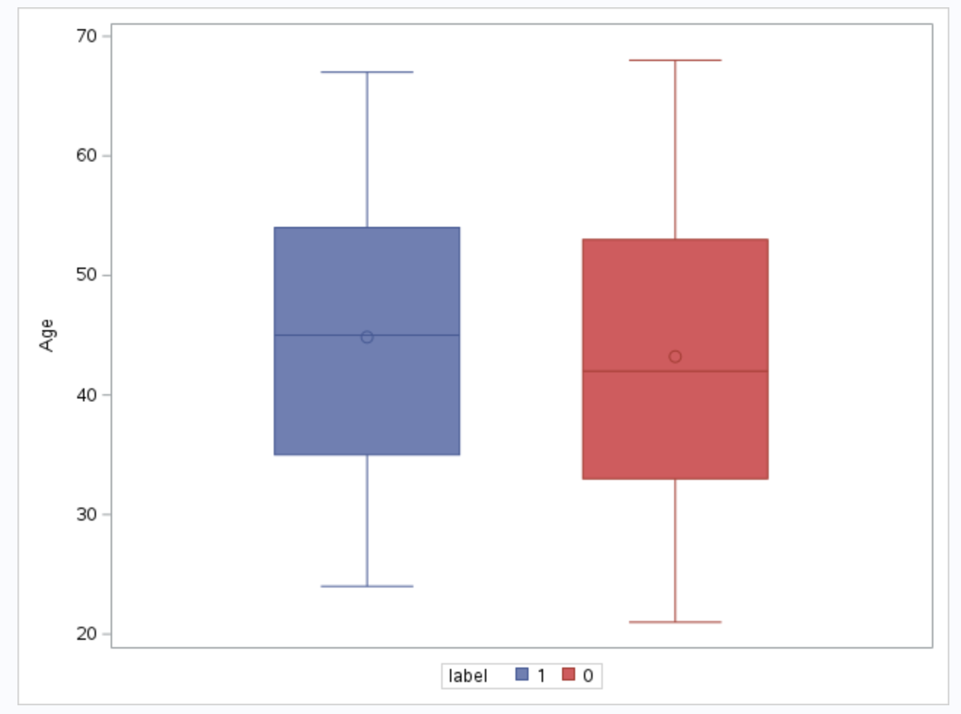




Descriptive Analysis &. Diagnostics Analysis :
• Bivariate Analysis (Numerical & Categorical) (predictor vs target )
T-test, The p-values<0.05 suggest that there are significant differences in the means of the variable "Employed_Year" between different levels of the categorical variable "label,
Equality of Variances test, P-values<0.05 indicates that the assumption of equal variances is rejected.

Slide 17



Descriptive Analysis &. Diagnostics Analysis :
• Bivariate Analysis (Numerical & Categorical) (predictor vs predictor )
Mean comparison for more than 2 groups: Proc Anova
The p-value (Pr > F) is less than the chosen significance level (usually 0.05), indicating that there are significant differences in the means of "Annual_income" across the different levels of " Type_Occupation."

Slide 18






Descriptive Analysis &. Diagnostics Analysis :
• Bivariate Analysis (Numerical & Categorical) (predictor vs predictor )

Slide 19






Descriptive Analysis &. Diagnostics Analysis :
• Bivariate Analysis (Numerical & Categorical) (predictor vs predictor )

Slide 20
Descriptive Analysis &. Diagnostics Analysis :
• Finding and conclusion & Summary of Bivariate Analysis
• All the numerical variables (Annual_income, Age, Employed_years) are not normal distributions.
• There are significant Pearson correlation coefficients between Annual_income and Employed_Year.
• Significant association exists between the Type_Income/Housing_type/Marital_status and the target label.
• The variables Propert_Owner/EDUCATION/Type_Occupation don't have an association with the target label.
• Significant association exists between GENDER and Car_Owner.
• There are significant differences means and variance of Employed_years by the level of lable.
• But we can not reject the Null hypothesis that have same means and equal variance for age and Annual_income.
• There are significant differences in the means of "Annual_income" across the different levels of Type_Occupation/GENDER/CHILDREN/Type_Income/EDUCATION/Marital_status/Housing_type.

Slide 21




Descriptive Analysis &. Diagnostics Analysis :
• Relationship estimates between the specified predictor variables and the response
The odds of the event occurring for “Co-op” are 18 times higher than the odds for “With parents”.
Somers' D is 0.33 suggests a moderate level of predictive discrimination.
The concordance index (c) is 0.665 suggests a moderate level of predictive discrimination.

Slide 22





Predictive Analysis for Logistic Regression
Notes:
Type 3 Analysis of Effects: Shows the Wald chi-square statistic and its corresponding p-value for each covariate in the model. These values indicate that Housing_type, Type_Income, Marital_status, and Employed_Day significantly affect the dependent variable label in the model.
Hosmer and Lemeshow Test: used to evaluate the goodness of fit of the model. The p value is 0.3783, which indicates that the model fits well and there is no sign of insufficient fit.
ROC Contrast Test Results: Comparative test results show the comparison of the model ROC curve with random guessing (AUC=0.5). The performance of the model here is significantly better than random guessing.
The ROC curve AUC shown in the first chart is 0.6752, indicating that the model has certain discrimination ability.
The second chart shows a ROC curve with an AUC of 0.7010, which generally indicates better model performance.

Slide 23




Predictive Analysis for Logistic Regression
Notes:
Evaluate the performance of classification models. The sensitivity, specificity, positive predictive value (PPV) and negative predictive value (NPV) of the model are calculated by comparing the predicted label (F_label(From: label)) and the actual label (I_label(Into: label))
Create a new CellCounts dataset, add a new variable Match to indicate whether the prediction is correct (when F_label equals I_label), and calculate the average of the Match variable, which is the overall accuracy of the model.
The proc means output shows that the average overall accuracy (Match) is approximately 86.64%, which means that the model correctly predicted approximately 86.64% of the samples.

Slide 24
Prescriptive Analysis
Prescriptive Solutions:
Enhance Targeted Marketing: Utilize model findings to focus on customer segments more likely to engage, such as specific Housing_type or income groups.
Improve Credit Decision-Making: Adjust credit policies based on key predictors like Employed_Day and Age to reduce default risks.
Customize Customer Services: Offer personalized services to cater to the needs of different customer segments identified by the models.
Impact on Outcome:
Increased Efficiency: Targeted marketing can lead to higher engagement and better use of resources.
Risk Reduction: Improved credit decision-making helps in lowering default rates.
Enhanced Customer Satisfaction: Personalized services lead to better customer experiences.
Deployment in Business:
Integrate Insights into Business Strategy: Apply model insights in marketing and credit risk management.
Train Teams: Educate relevant departments on leveraging these insights.
Regular Updates and Monitoring: Continuously refine strategies based on new data and feedback for ongoing improvement.

Slide 25
High Level Findings:
Housing Type Significantly Correlates with Credit Card Application Outcomes:
Applicants living in co-op apartments have a higher likelihood of rejection compared to those in municipal apartments, while those living with parents have a lower likelihood. This suggests housing environment may reflect an applicant's financial stability or credit risk.
Marital Status is a Significant Risk Factor:
Single applicants have a lower risk of rejection compared to those who are married or in a civil union. This could relate to different financial circumstances associated with married individuals or those in civil unions.
Family Member Count Significantly Affects Application Outcomes:
Applicants with a higher number of family members are more likely to be rejected compared to single applicants, potentially pointing to the impact of family obligations and responsibilities on credit card approval.
Specific Personal Attributes Correlate with Application Outcomes:
Gender and days employed also show significant effects on the outcome of credit card applications, with females having a lower likelihood of rejection compared to males, and applicants with fewer days of employment having a higher likelihood of rejection.

Slide 26
Recommendations :
Enhance Risk Assessment Models:
Incorporate housing type as a predictor in credit risk assessment models to better gauge financial stability. Co-op apartment residents may require additional scrutiny, whereas living with parents could be seen as a positive signal.
Marital Status as a Risk Modifier:
Adjust credit scoring algorithms to reflect the marital status of applicants. Given that single applicants tend to have lower rejection rates, marital status should be factored in to assess financial obligations that might affect creditworthiness.
Family Size Consideration:
Develop strategies for applicants with larger family sizes since they show a higher likelihood of rejection. This could involve offering financial planning resources or products tailored to applicants with dependents.
Employment History Verification:
Implement stricter verification processes for employment history as a lower number of employed days is associated with higher rejection rates. Longer employment history could be incentivized or considered a stabilizing factor in the application process.

Slide 27

Thank you
Q & A

